Slide 1
WIF2001/WKES2107: Tutorial 4
Human Computer Interaction
Dr Raja Jamilah Raja Yusof

Slide 2
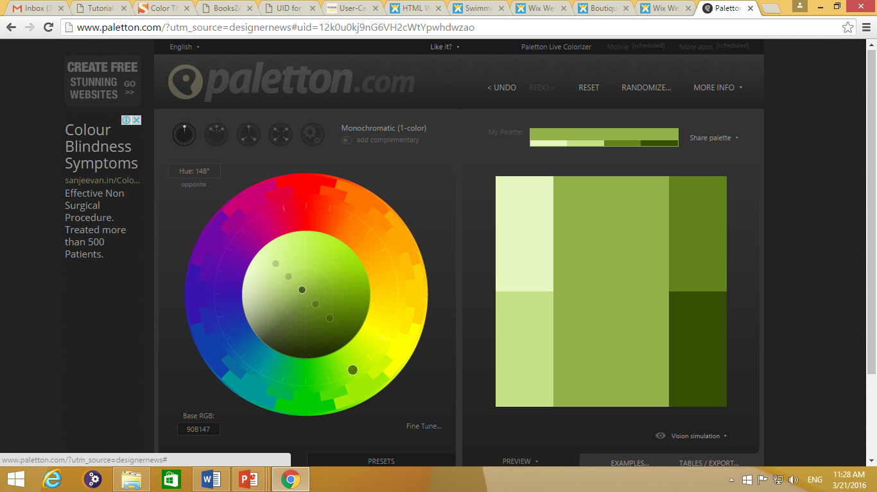
http://www.paletton.com/

Slide 3
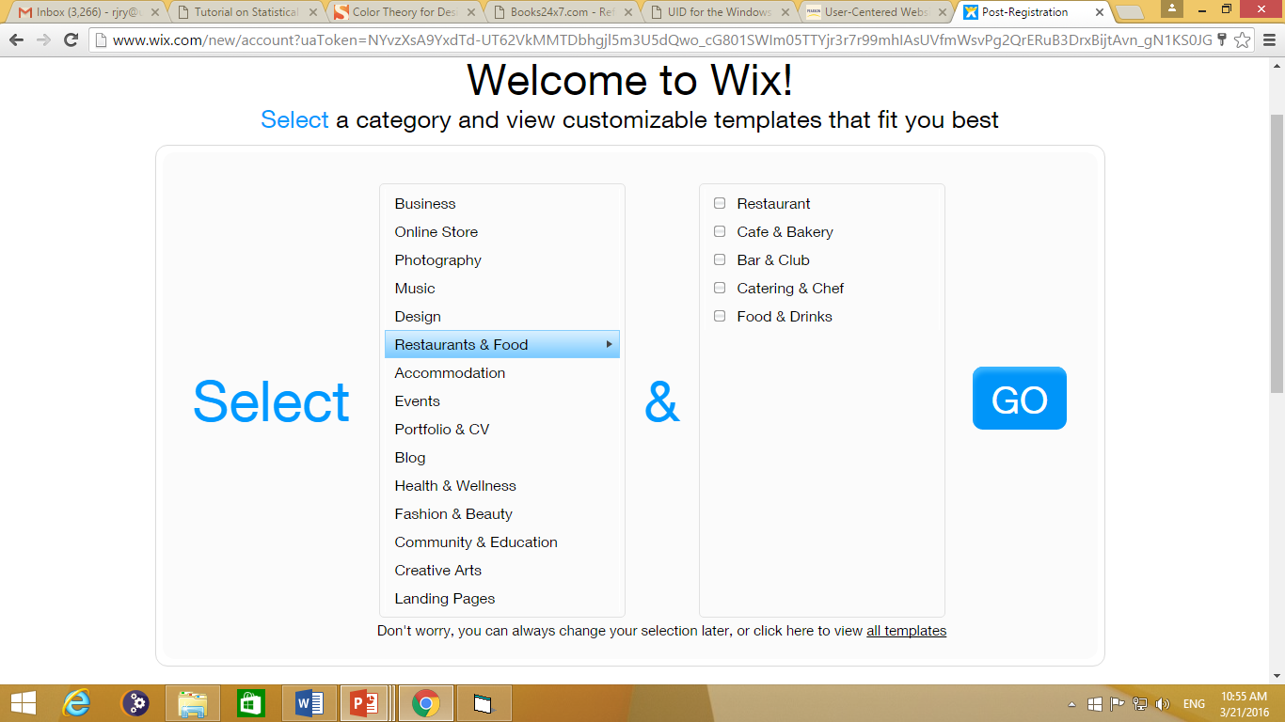
http://www.wix.com/

Slide 4
Group Assignment (Due date 16/3/2017)
What to do:
Go through the paletton.com website to explore colour combination for good web design
In a group of 4 to 5 people, go to wix.com website to rapidly create a website interface based on the followings:
Use the four colour harmony scheme to your website
Screen shot the same website for each of the colour harmony scheme
Justify your claims (For example, say why you say screen shot A or B or C is using a specific colour harmony)
Design a specific part of your webpage so that it contains a description of your website. Use a suitable font. Justify why you use that font.
Design a specific part of your webpage so that it contains a big and brief text as an element of attraction. Justify why you choose
the colour of the text,
the background of the text and
The font of the text

